Slide 1
Modified Kinetic Theory for the Flow of Dense Particulate Mixtures and Granular Materials
Yifei Duan, ¹ Zhi-Gang Feng,¹ and Efstathios E. Michaelides²
¹ Mechanical Engineering, UTSA, San Antonio, USA ² Engineering, TCU, Fort Worth, USA

Slide 2
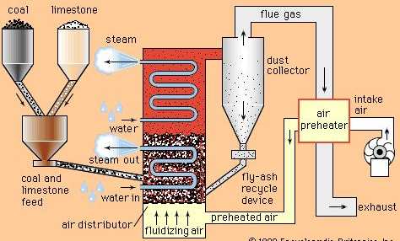
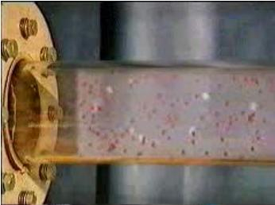
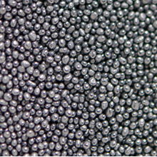
Granular flow/Particulate flow
Dilute flows are fairly accurately modeled; intermediate, dense, and granular multiphase flows are not as accurately modeled even though they present a great deal of interest for industrial and environmental applications.

Slide 3
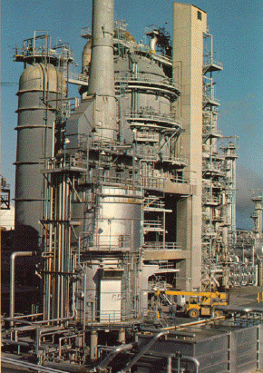
Industrial Multiphase Flows
An actual industrial Fluidized Bed Reactor system entails all the flow regimes and contains trillions of particles.
The behavior of each one of the trillions of individual particles is neither of interest, nor can it be accurately modeled.
→ Need to use continuum methods within the constraints of the needed accuracy.

Slide 4
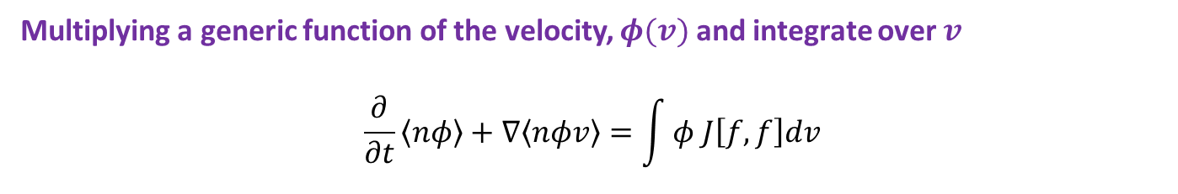
Kinetic Theory for Dense and Granular Flow
Boltzmann equation:
Binary collision integral:
Multiplying a generic function of the velocity, $φ(v)$ and integrate over $v$
$$\frac{∂}{∂t}\left\langle nφ\right\rangle +∇\left\langle nφv\right\rangle =\int{φ J\left[f,f\right]dv}$$
If we let $φ=1, v and v^{2},$ we derive the conservation equations for mass, momentum, and energy:

Slide 5
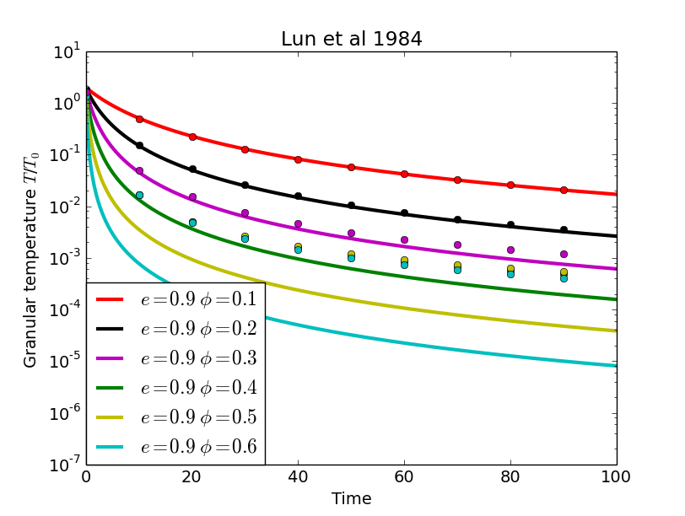

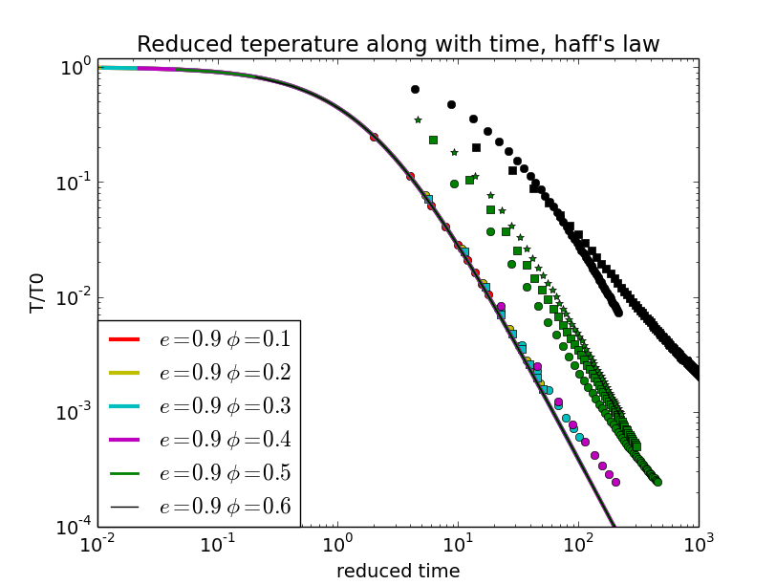

The kinetic theory in freely cooling case
For dense systems the Kinetic Theory (KT) is not accurate because the energy dissipation rate is overestimated.
Extensions are needed.
Haff’s law:
Notes:
Test this problem using different system

Slide 6
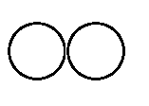
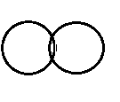
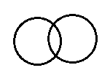

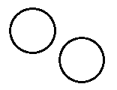
Modified Kinetic Theory for Multi-body Collisions
Classical kinetic theories have been derived with only instant binary collisions. However in the dense systems sustained multi-particle contacts prevail and the KT is inaccurate.
Soft sphere, DEM
Kinetic theory (instant binary collision)
Particle collisions are processes that take finite time. Part of the kinetic energy may be stored in elastic deformations during contact and not dissipated
A KT approach without elastic deformations will overestimate the dissipated energy, especially in dense systems.

Slide 7
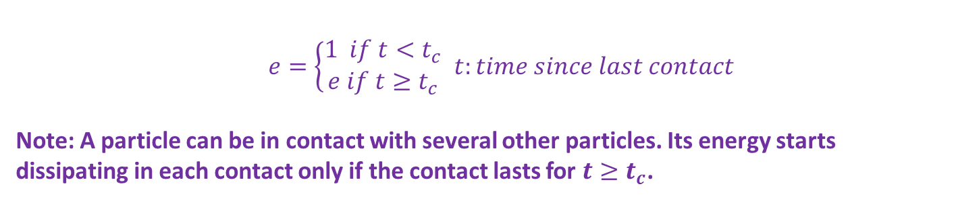
Modified Kinetic Theory for Multi-body Collisions
First modification to the Inelastic Hard Sphere (IHS) model in KT: The “contact duration” concept: part of the kinetic energy is stored reversibly.
$e=\left\{\begin{aligned}1 if t<t_{c} \\ e if t≥t_{c}\end{aligned}\right.$ $t:time since last contact$
Note: A particle can be in contact with several other particles. Its energy starts dissipating in each contact only if the contact lasts for $t≥t_{c}$.
More Details in:
Duan, Y.F, Feng, Z-G, Michaelides, E, Mao, S.L, “Modified Kinetic Theory Applied to the Shear Flow of Granular Materials.” Physics of Fluids, 29(4):043302, (2017).
Duan, Y.F, Feng, Z-G, “Incorporation of Velocity-dependent Restitution Coefficient and Surface Friction of Particles into Kinetic Theory for Modeling Granular Flow Cooling Process”, Physical Review E 96(6):062907, (2018).

Slide 8
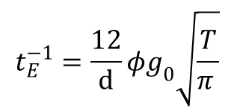
Modified Kinetic Theory for Multi-body Collisions
Based on DEM simulation results with IHSs the energy dissipation rate in the Kinetic Theory was modified as follows:
$$t_{E}^{−1}=\frac{12}{d}φg_{0}\sqrt{\frac{T}{π }}$$
Note: K is the ratio of the kinetic energy to the total energy of the system (kinetic energy and elastic potential energy).

Slide 9
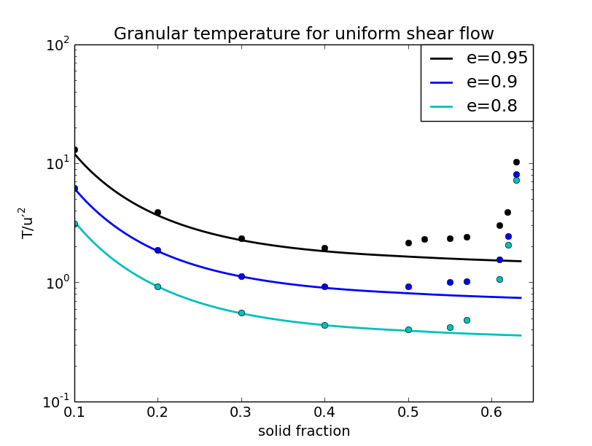
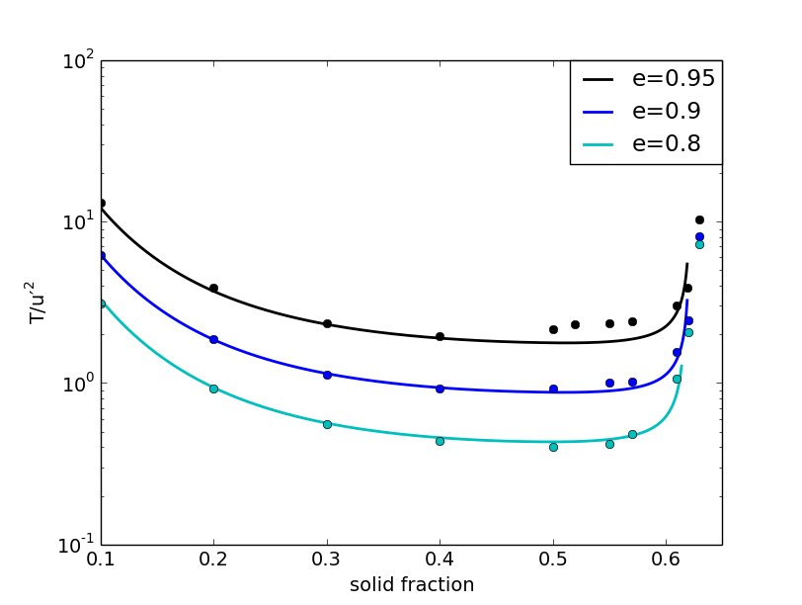
Modified Kinetic Theory for Multi-body Collisions
applied to Uniform Shear Flows
There is an improvement, but at the higher solid fractions the flow falls into the elastic regime where particles form a “force chain” network.

Slide 10
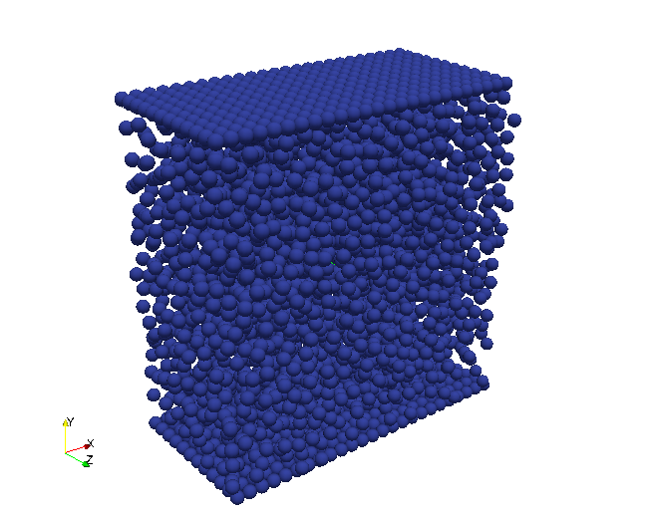
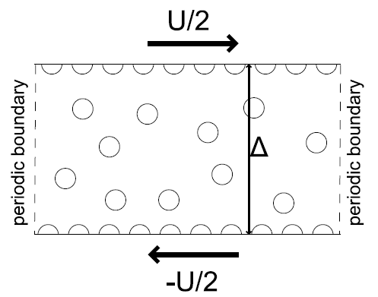
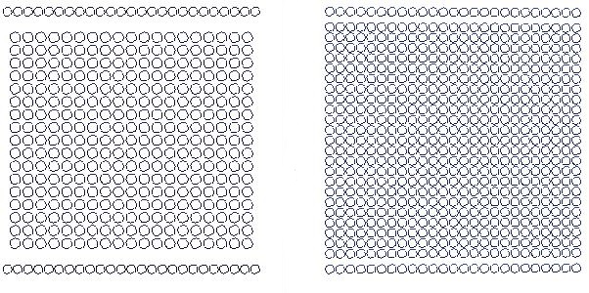
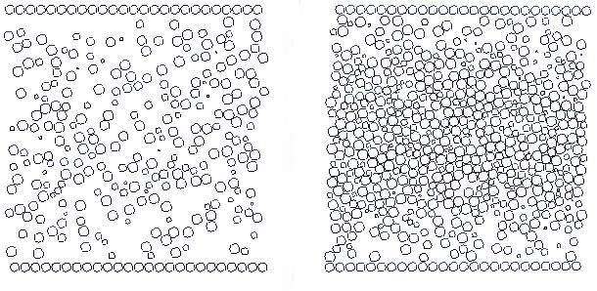
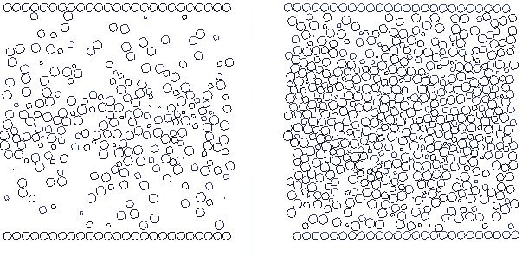
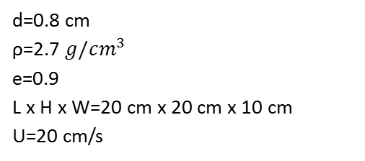
Modified Kinetic Theory applied to Plane Shear Flow
d=0.8 cm
ρ=2.7 $g/cm^{3}$
e=0.9
L x H x W=20 cm x 20 cm x 10 cm
U=20 cm/s
(a): t=0sec (left: 3507 particles; right: 7500 particles)
(b): t=10sec (left: 3507 particles; right: 7500 particles)
φ=0.193
φ=0.462
(φ_{max}=0.636)
(c): t=60sec (left: 3507 particles; right: 7500 particles)

Slide 11
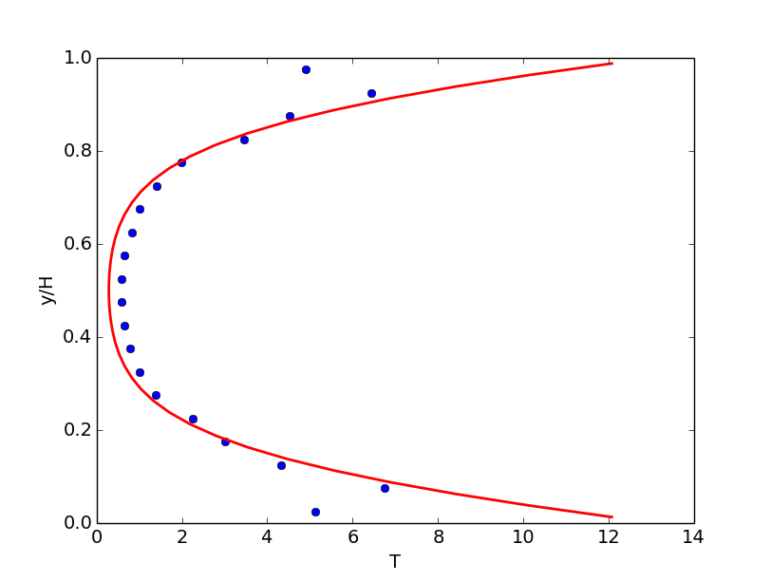
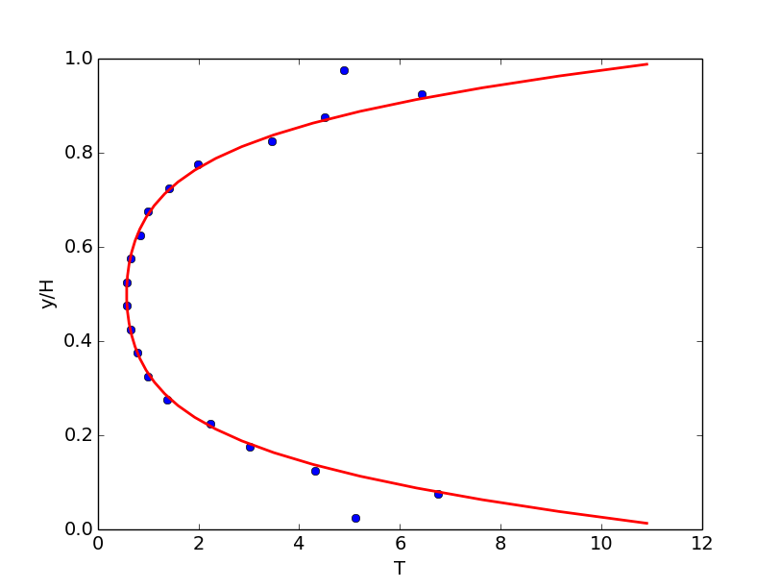
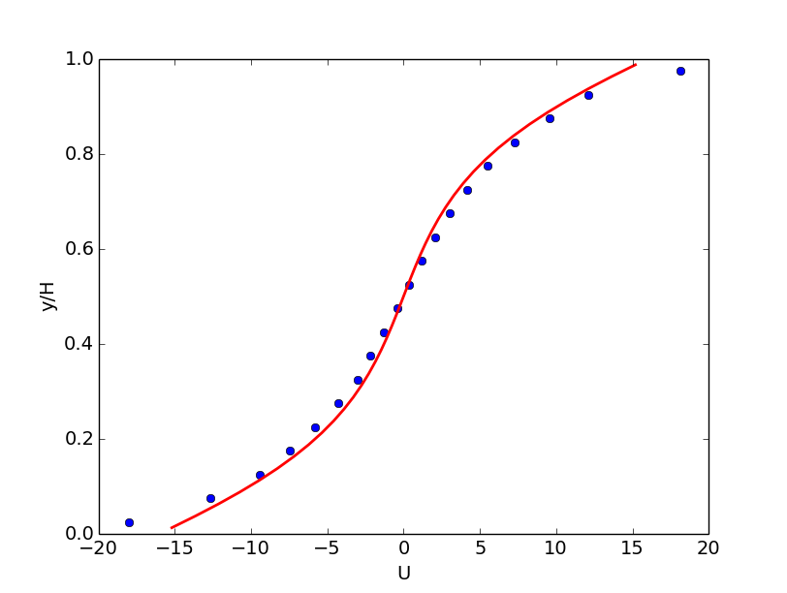
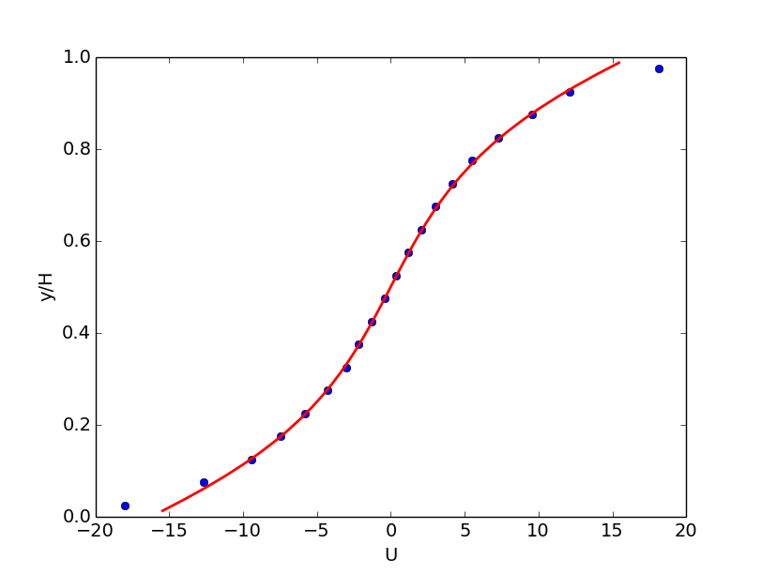
Granular Temperature and Velocity Profile
DEM result (dots) and theoretical solution from original (left) and modified KT model (right)

Slide 12
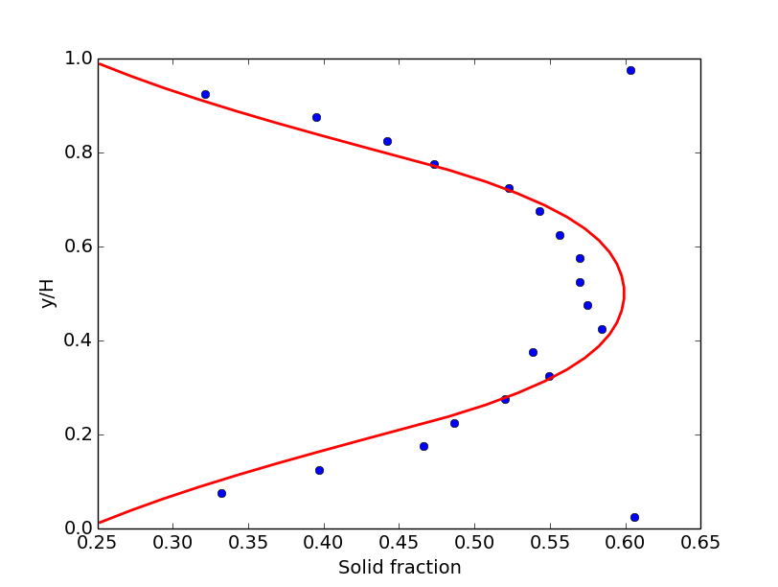
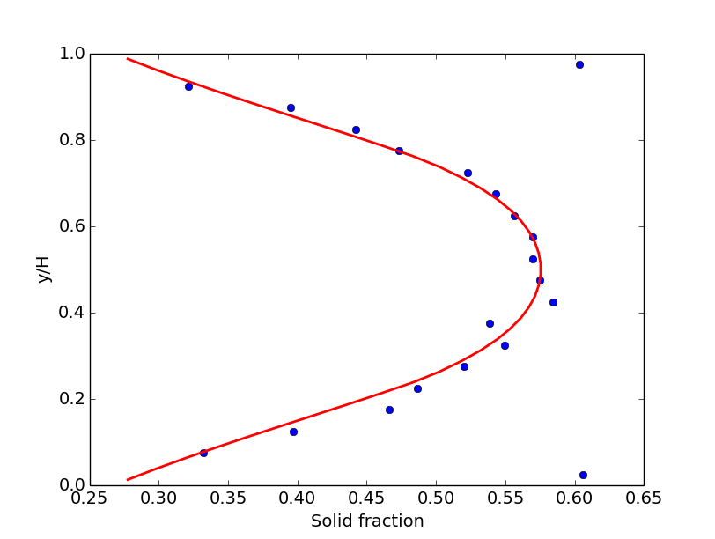
Volume fraction profile of solids, φ
DEM result (dots) and theoretical solution from original (left) and modified KT model (right)

Slide 13
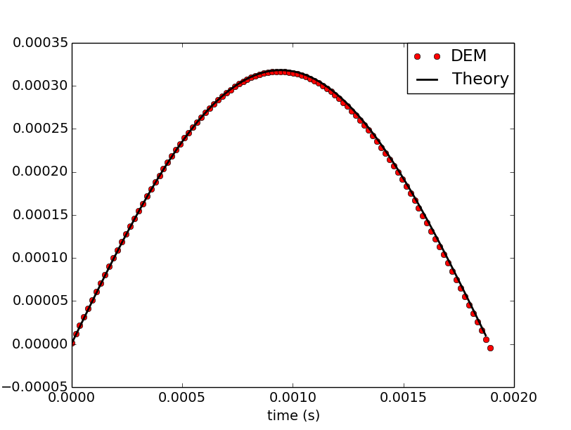

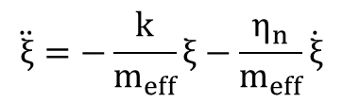
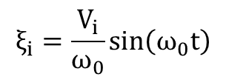
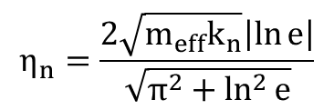

Modeling the Elastic Energy
Linear-spring-dashpot collision scheme:
$$\ddot{ξ}=−\frac{k}{m_{eff}}ξ−\frac{η_{n}}{m_{eff}}\dot{ξ}$$
$$η_{n}=\frac{2\sqrt{m_{eff}k_{n}}\left|\ln{e}\right|}{\sqrt{π^{2}+\ln^{2}{e}}}$$
If we consider the system is nearly elastic (i.e., $e\sim 1$)
$$ξ_{i}=\frac{V_{i}}{ω_{0}}\sin\left(ω_{0}t\right)$$
Where $V_{i}$ is the normal relative velocity component at the point of contact of $i^{th}$ collision, and $ω_{0}=\sqrt{\frac{k_{n}}{m_{eff}}}$
The time-averaged square of the normal overlap ${\overline{ξ}}_{i}^{2}=f\left(V_{i}\right)$

Slide 14
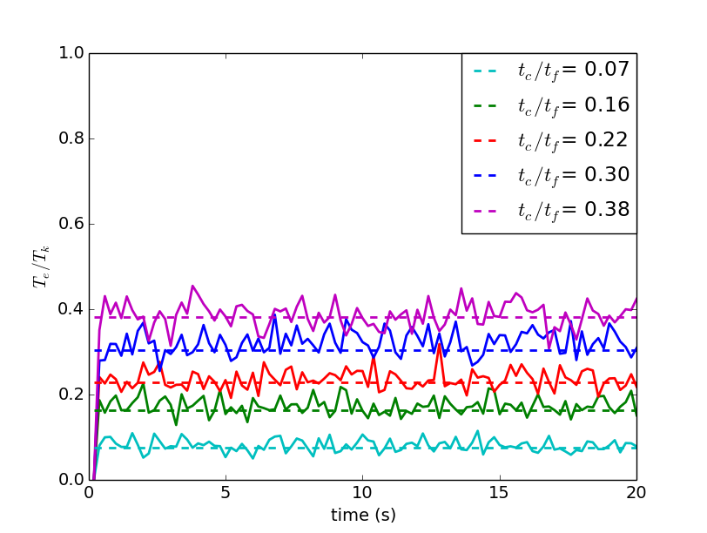
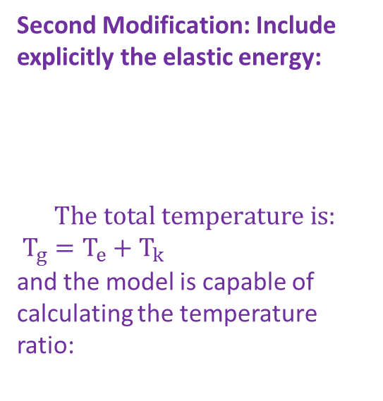
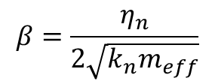
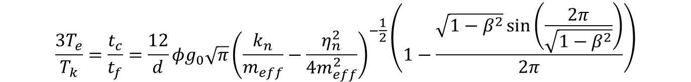
Comparison with DEM
Second Modification: Include explicitly the elastic energy:
$$The total \text{temperature} is:$$
$T_{g}=T_{e}+T_{k}$
and the model is capable of calculating the temperature ratio:
$$\frac{{3T}_{e}}{T_{k}}=\frac{t_{c}}{t_{f}}=\frac{12}{d}φg_{0}\sqrt{π}{\left(\frac{k_{n}}{m_{eff}}−\frac{η_{n}^{2}}{4m_{eff}^{2}}\right)}^{−\frac{1}{2}}\left(1−\frac{\sqrt{1−β^{2}}\sin\left(\frac{2π}{\sqrt{1−β^{2}}}\right)}{2π}\right)$$
t_{c}: collision time
t_{f}: flight time
$$β=\frac{η_{n}}{2\sqrt{k_{n}m_{eff}}}$$

Slide 15
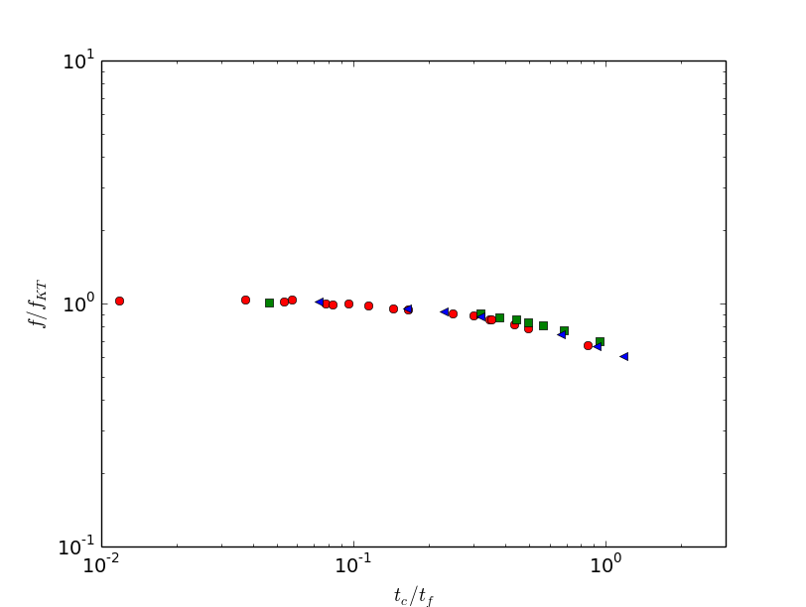
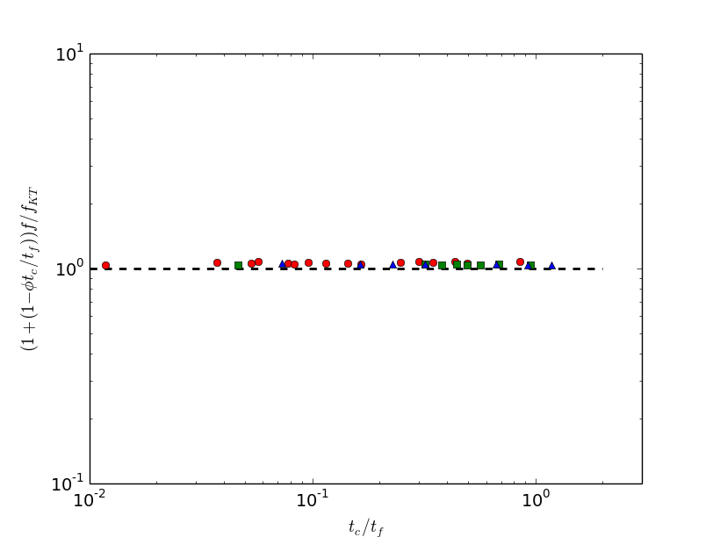
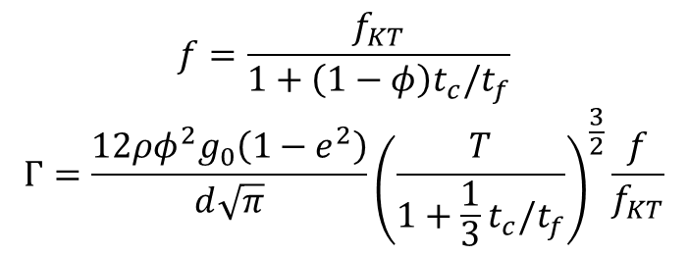
A Consequence: Reduced Collision Frequency
$$f=\frac{f_{KT}}{1+\left(1−φ\right)t_{c}/t_{f}}$$
$$Γ=\frac{12ρφ^{2}g_{0}\left(1−e^{2}\right)}{d\sqrt{π}}{\left(\frac{T}{1+\frac{1}{3}t_{c}/t_{f}}\right)}^{\frac{3}{2}}\frac{f}{f_{KT}}$$
Only kinetic temperature determines the collision frequency
Reduced collision frequency due to particle deformation

Slide 16
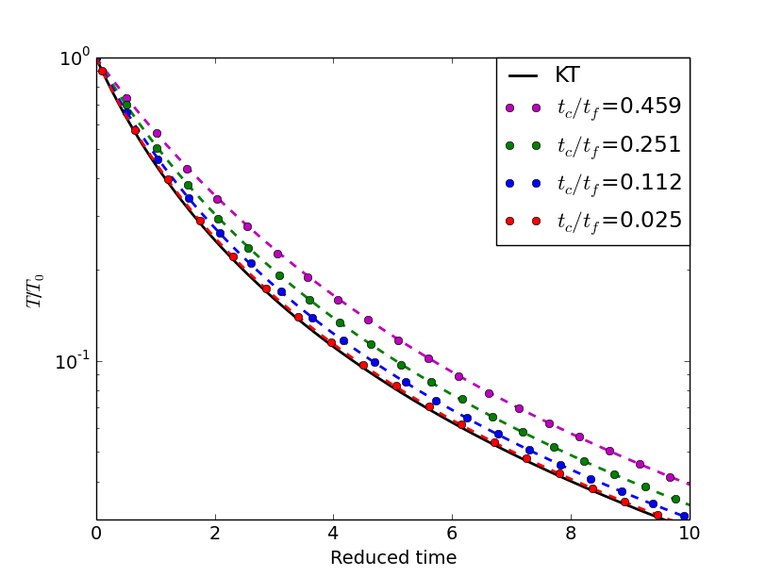
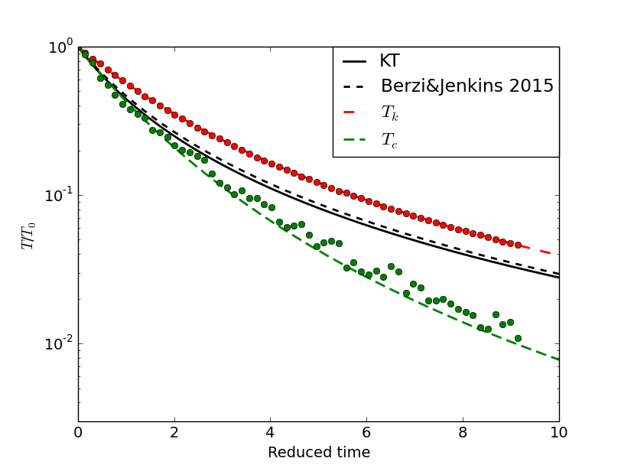
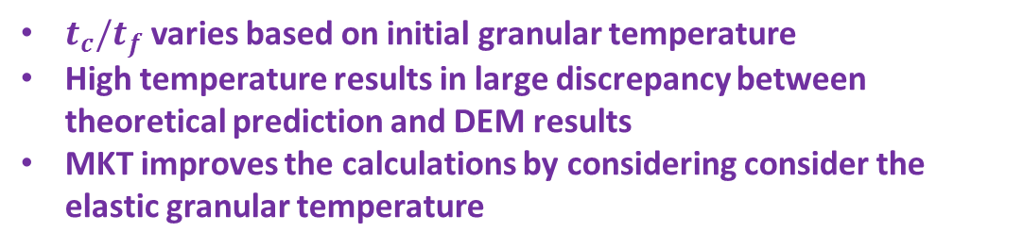
Homogeneous Cooling Cases – Granular Flows
t_{c}/t_{f}=0.459
$t_{c}/t_{f}$ varies based on initial granular temperature
High temperature results in large discrepancy between theoretical prediction and DEM results
MKT improves the calculations by considering consider the elastic granular temperature

Slide 17
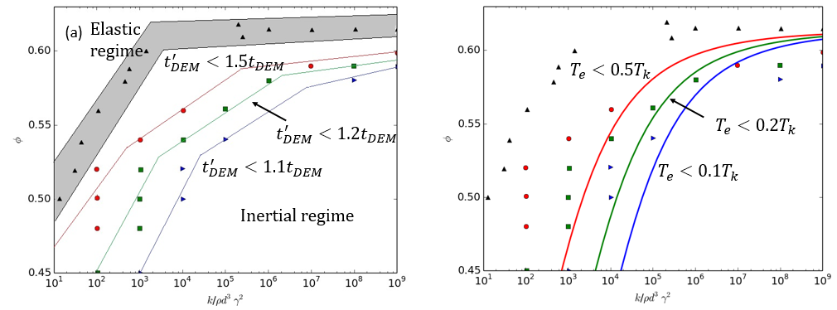
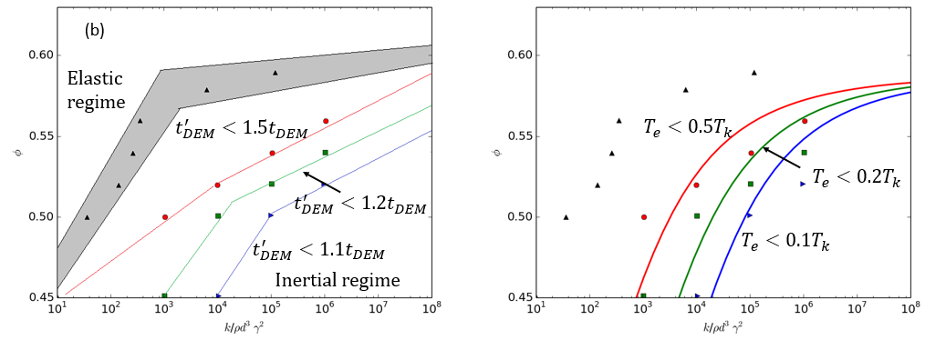
Redraw the Regime Map based on Elastic Energy
$μ=0.1$, left: fit with Campbell data*; right: numerical using proposed theory
$\left(b\right) μ=0.5$, left: fit with Campbell data*; right: numerical using proposed theory
*Campbell, C. S. (2002). "Granular shear flows at the elastic limit." Journal of fluid mechanics 465: 261-291.

Slide 18
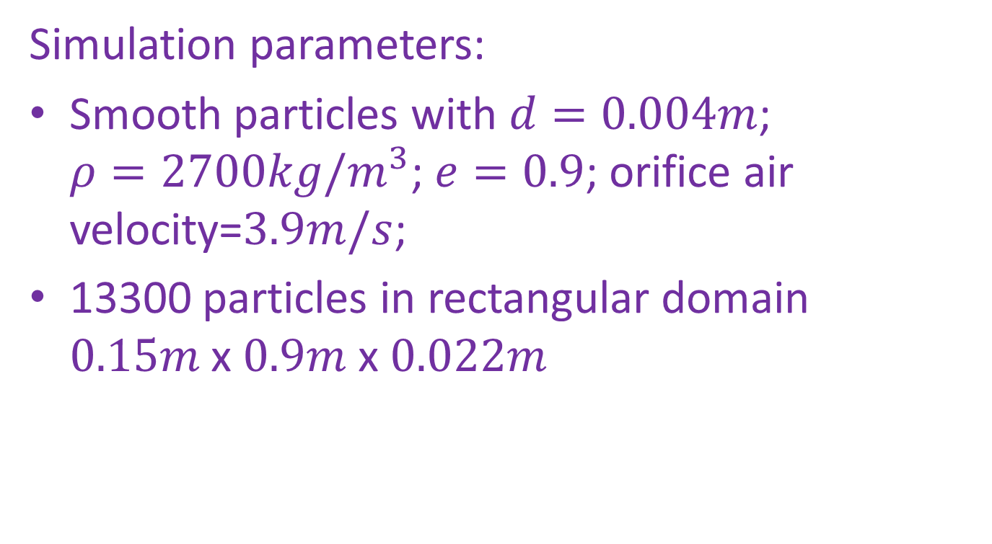
Fluidized Bed Simulation
Simulation parameters:
Smooth particles with $d=0.004m$; $ρ=2700kg/m^{3}$; $e=0.9$; orifice air velocity=$3.9m/s$;
13300 particles in rectangular domain $0.15m$x $0.9m$ x $0.022m$

Slide 19
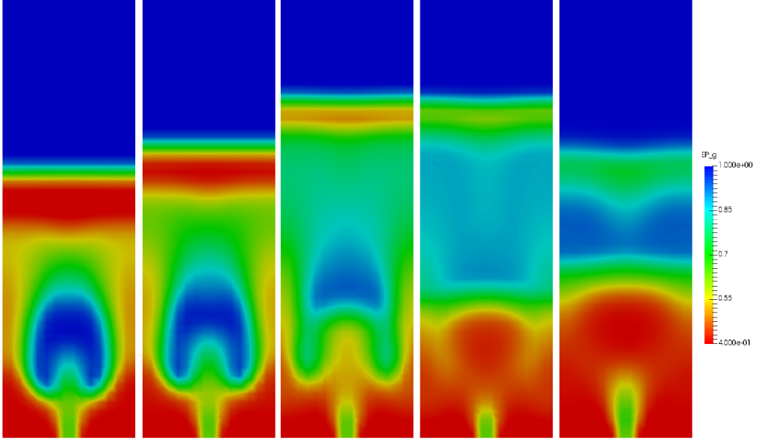
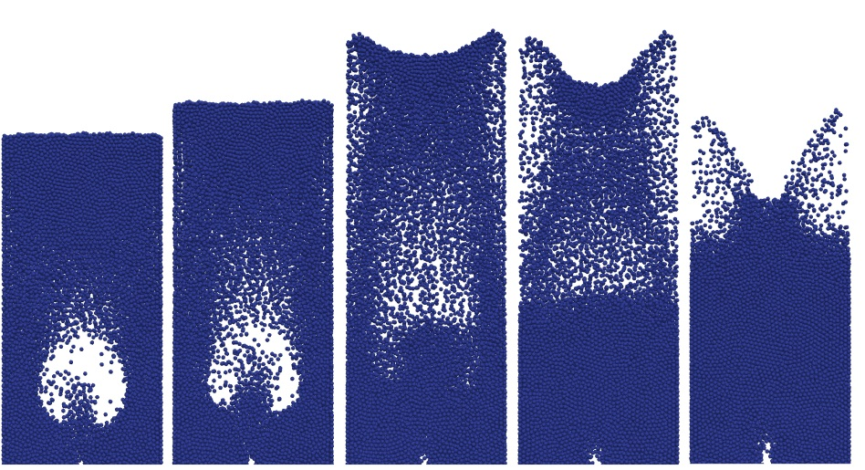
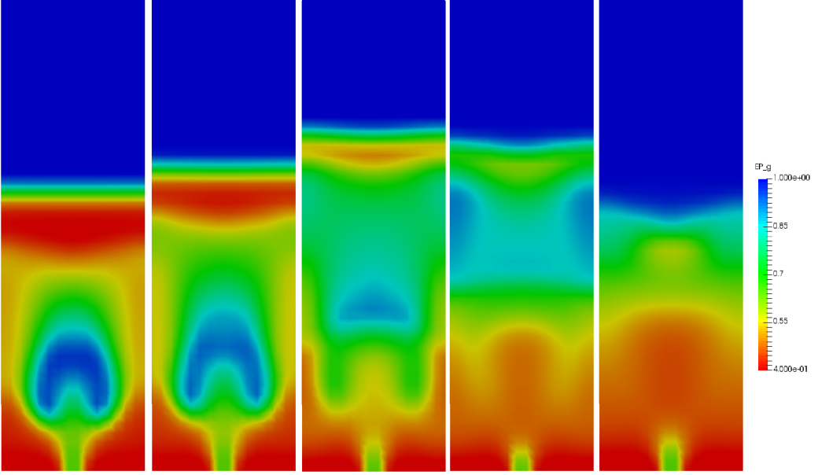
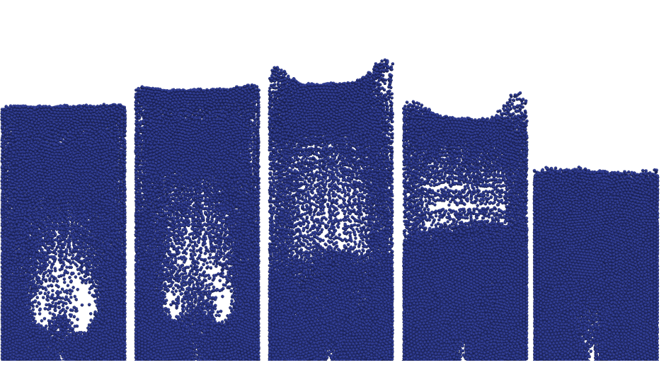
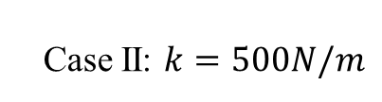
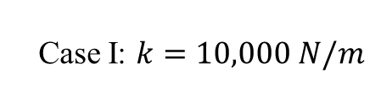
Comparison with DEM - A
Case I: $k=10,000 N/m$
Case II: $k=500N/m$
0.18sec 0.22sec 0.33sec 0.43sec 0.53sec
Softer particles:
Reduced bubble size
Lower fluidization height
Bubble cycles are shorter

Slide 20

Comparison with DEM - B

Slide 21

Conclusions
Particle interaction processes take finite time to occur and particle collisions are partly elastic.
The large discrepancy observed between kinetic theory prediction and DEM results at high solid volume fraction emanates from the particle elasticity that classical kinetic theory does not include.
We modified the current collision model by quantifying the elasticity of particles, via a cut-off time, $t_{c}=t_{DEM}$, which is obtained from DEM simulations, and by quantifying the fraction of elastic energy via a Linear-Spring-Dashpot model.
Improvement of results and trends are observed in both cases. The improvement is more noticeable in the plane shear flow case, where accurate results are obtained up to solid fractions of 0.57.
The quantification of the elastic energy, as T_{e}, leads to a finer demarcation of the inertia-elastic granular flow regimes’ map.

